Slide 1
M2M and IoT

Slide 2
Introduction
Machine-to-machine, or M2M, is a broad label that can be used to describe any technology that enables networked devices to exchange information and perform actions without the manual assistance of humans.
M2M technology was ﬁrst adopted in manufacturing and industrial settings, and later found applications in healthcare, business, insurance and more.
It is also the foundation for the internet of things.
M2M and IoT both refer to devices communicating with each other.
M2M refers to isolated instances of device-to-device communication.
IoT refers to a grander scale, synergizing vertical software stacks to automate and manage communications between multiple devices.

Slide 3
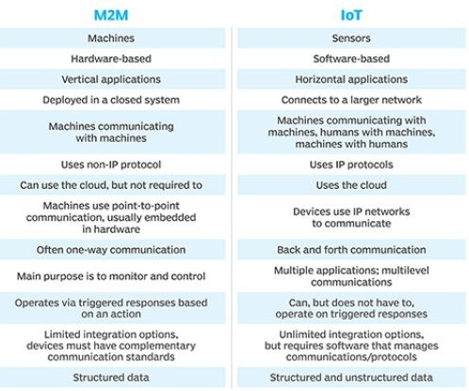
Difference

Slide 4
How M2M Works
The main purpose of machine-to-machine technology is to tap into sensor data and transmit it to a network.
M2M systems often use public networks and access methods - for example, cellular or Ethernet - to make it more cost-eﬀective.
Energy eﬃciency and wireless connectivity are the key for M2M / IoT.
M2M Communication is a subset of IoT.
IoT comprises M2M and H2M (Human to Machine) communication.
In practice the IoT will consist of hybrid infrastructure of non IP and IP connected devices through IP connected gateways.

Slide 5
One of the most well-known types of machine-to-machine communication is telemetry, which has been used since the early part of the last century to transmit operational data.
Pioneers in telemetrics ﬁrst used telephone lines, and later, radio waves, to transmit performance measurements gathered from monitoring instruments in remote locations.
The internet and improved standards for wireless technology have expanded the role of telemetry from pure science, engineering and manufacturing to everyday use in products such as heating units, electric meters and internet-connected devices, such as appliances.

Slide 6
Benefits of M2M
Reduced costs by minimizing equipment maintenance and downtime.
Boosted revenue by revealing new business opportunities for servicing products in the ﬁeld.
Improved customer service by proactively monitoring and servicing equipment before it fails or only when it is needed.

Slide 7
Network QoS Requirement
M2M communication is diﬀerent from the voice communication as size of data in M2M may vary from few bytes (meter reading) to several MBs (surveillance video).
M2M services requirement
Timely transmission is of utmost important.
Communication network is required to be more reliable with low latency

Slide 8
Applications
Machine-to-machine communication is often used for remote monitoring.
M2M devices can enable the real-time monitoring of patients' vital statistics, dispensing medicine when required, or tracking healthcare assets.
M2M is also an important aspect of remote control, robotics, traﬃc control, security, logistics and ﬂeet management, and automotive.

Slide 9
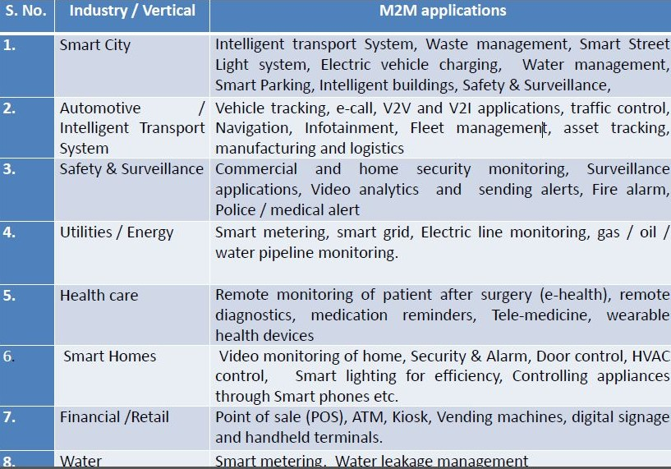

Slide 10
Enabling Technologies for M2M
Sensor networks, Radio frequency Identiﬁcation (RFID) chips, GPS, Location-Based Services (LBS), nanotechnologies, cloud services, data analytics.
WLAN (IEEE 802.11), Bluetooth Low Energy (BLE), NFC, DSRC for short range
communication.
Low Power RF for LAN / FAN such as 6LowPAN, Zigbee, Zwave, Wi-SUN etc
Cellular 2G/ 3G/ LTE / Satellite for Long range communication depending upon the
applications.
Wire line BB / Lease line to connect infrastructure
Power Line Communication Technologies: Narrowband PLC for LAN and Broadband PLC
for WAN
Low power RF for WAN: LoRa, Sigfox
Embedded SIM
Static IP (IPv4 / IPv6)
Smart Phone
High speed internet on ﬁxed line and mobile phones.

Slide 11
Backbone Network
Smooth & high speed WiFi coverage
Control plane at the center whereas data may be in distributed servers.
Data centers in the cloud for storing large amount of data from the devices.
Big data analytics to create intelligence.
Use of intelligence for diﬀerent activities.
Open APIs
RFID based system.

Slide 12
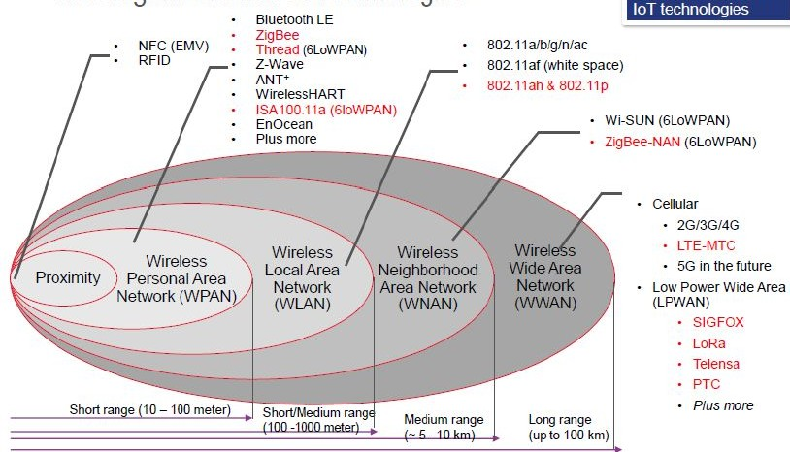

Slide 13
Challenges and Need for standards in M2M
Lack of standards and interoperable technologies
Technologies for sustainability or low power consumption / long life batteries required for sensors.
There should be interoperability at device, network and application levels.
Slow deployment of IPv6
Low cost devices (aﬀordability)
Data Security & Privacy
Health care regulations

Slide 14
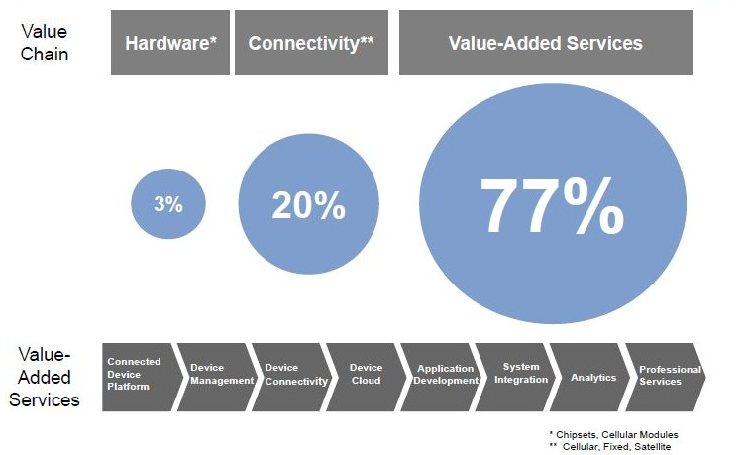
M2M Value Chain

Slide 15
Wireless Sensor Network
Consists of a large number of sensor nodes, densely deployed over an area.
Sensor nodes are capable of collaborating with one another and measuring the condition of their surrounding environments (i.e. Light, temperature, sound, vibration).
The sensed measurements are then transformed into digital signals and processed to reveal some properties of the phenomena around sensors.
Due to the fact that the sensor nodes in WSNs have short radio transmission range, intermediate nodes act as relay nodes to transmit data towards the sink node using a multi‐hop path.

Slide 16
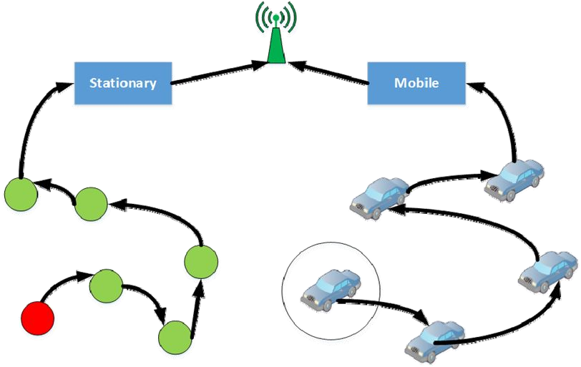
Multihop Communication in WSN

Slide 17
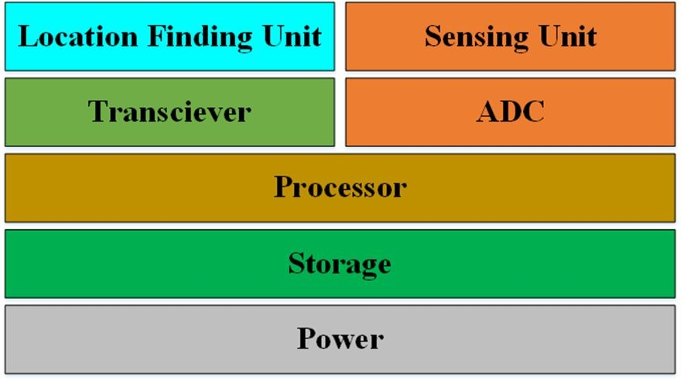
Basic Components of Sensor Node

Slide 18
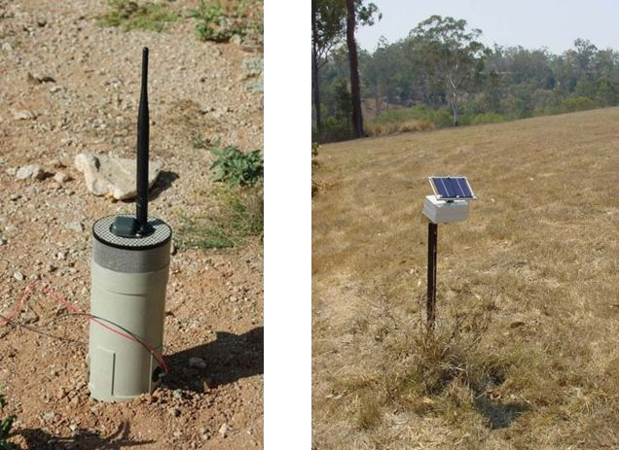
Sensor Node
Multifunctional
The number of sensor nodes used depends on the application type.
Short transmission ranges
Have OS (e.g., TinyOS).
Battery Powered – Have limited life.

Slide 19
Constraints
Small size, typically less than a cubic cm.
Must consume extremely low power
Operate in an unattended manner in a highly dense area.
Should have low production cost and be dispensable
Be autonomous
Be adaptive to the environment

Slide 20
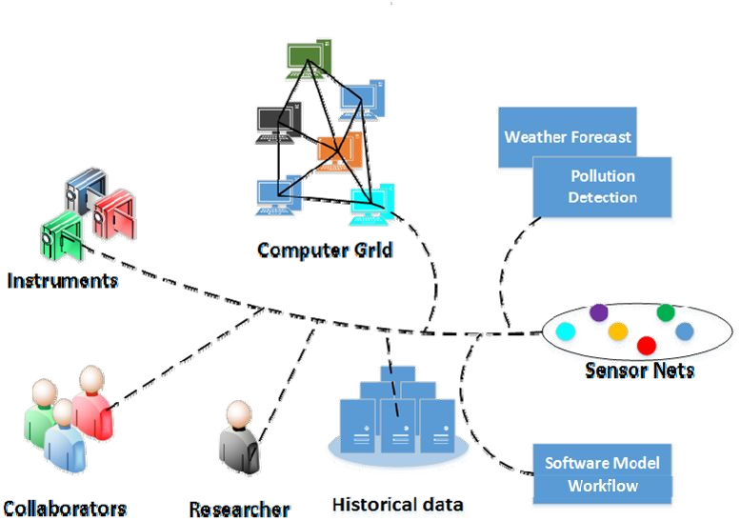
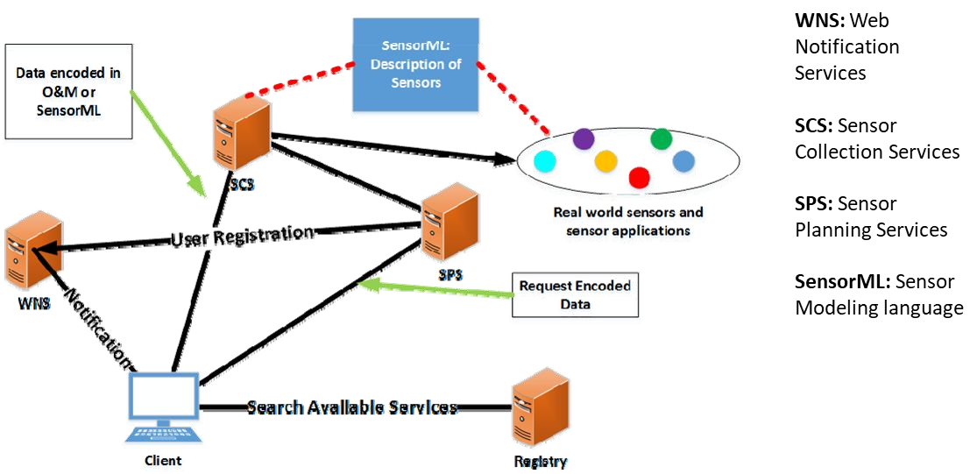
Sensor Web

Slide 21
Challenges
Scalability
Providing acceptable levels of service in the presence of large number of nodes.
Typically, throughput decreases at a rate of number of nodes increases.
Quality of service
Offering guarantees in terms of bandwidth, delay, jitter, packet loss probability.
Limited bandwidth, unpredictable changes in RF channel characteristics.
Energy efficiency
Nodes have limited battery power
Nodes need to cooperate with other nodes for relaying their information.
Security
Open medium.
Nodes prone to malicious attacks, infiltration, eavesdropping, interference

Slide 22
Security Challenges
Open, shared radio medium by the nodes, which dynamically change positions.
No centralized network management or certification authority.
Existence of malicious nodes.
Nodes prone to attacks, infiltration, eavesdropping, interference.
Nodes can be captured, compromised, false routing information can be sent – paralyzing the whole network.
The cooperating node or the node being cooperated might be victimized.

Slide 23
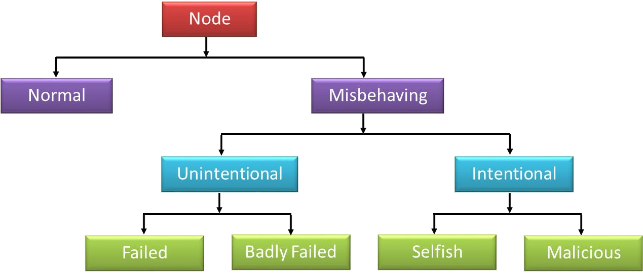
Node Behaviour in WSN

Slide 24
Node Behaviour in WSN…
Normal nodes work perfectly in ideal environmental conditions
Failed nodes are simply those that are unable to perform an operation; this could be because of power failure and environmental events.
Badly failed nodes exhibit features of failed nodes but they can also send false routing messages which are a threat to the integrity of the network.
Selfish nodes are typified by their unwillingness to cooperate, as the protocol requires whenever there is a personal cost involved. Packet dropping is the main attack by selfish nodes.
Malicious nodes aim to deliberately disrupt the correct operation of the routing protocol, denying network service if possible.

Slide 25
Dynamic Misbehaviour: Dumb Node
Detection of such temporary misbehavior in order to preserve normal functioning of the network – coinage and discovery of dumb behavior
In the presence of adverse environmental conditions (high temperature, rainfall, and fog) the communication range shrinks
A sensor node can sense its surroundings but is unable to transmit the sensed data
With the resumption of favorable environmental conditions, dumb nodes work normally
Dumb behavior is temporal in nature (as it is dependent on the effects of environmental conditions)

Slide 26
Detection and connection re-establishment
The presence of dumb nodes impedes the overall network performance
Detection, and, subsequently, the re-establishment of network connectivity is crucial
The sensed information can only be utilized if the connectivity between each dumb node with other nodes in the network could be
re-established
Before restoration of network connectivity, it is essential to detect the dumb nodes in the network.
CoRD and CoRAD are two popular schemes that re-establish the connectivity between dumb nodes with others.

